Slide 1
COEN 243: Programming Methodology I Lecture 2: Classes and Objects

Slide 2
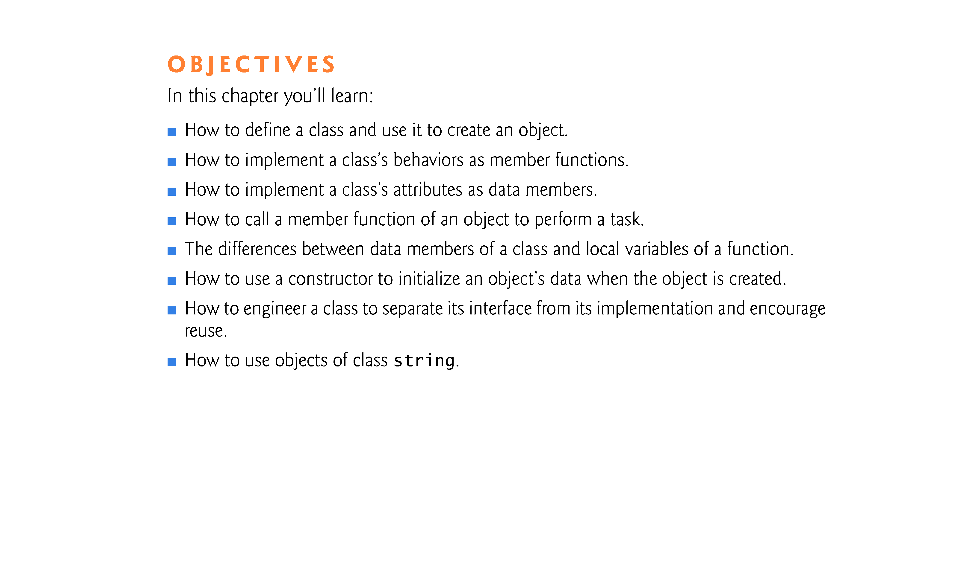

Slide 3
3.1 Introduction
In this chapter, you’ll begin writing programs that employ the basic concepts of object-oriented programming that we introduced in Section 1.8.
Typically, the programs you develop in this book will consist of function main and one or more classes, each containing data members and member functions.
In this chapter, we develop a simple, well-engineered framework for organizing object-oriented programs in C++.

Slide 4
3.2 Defining a Class with a Member Function
We begin with an example (Fig. 3.1) that consists of class GradeBook (lines 8–16), which, when it is fully developed in Chapter 7, will represent a grade book that an instructor can use to maintain student test scores, and a main function (lines 19–23) that creates a GradeBook object.
Function main uses this object and its displayMessage member function to display a message on the screen welcoming the instructor to the grade-book program.

Slide 5
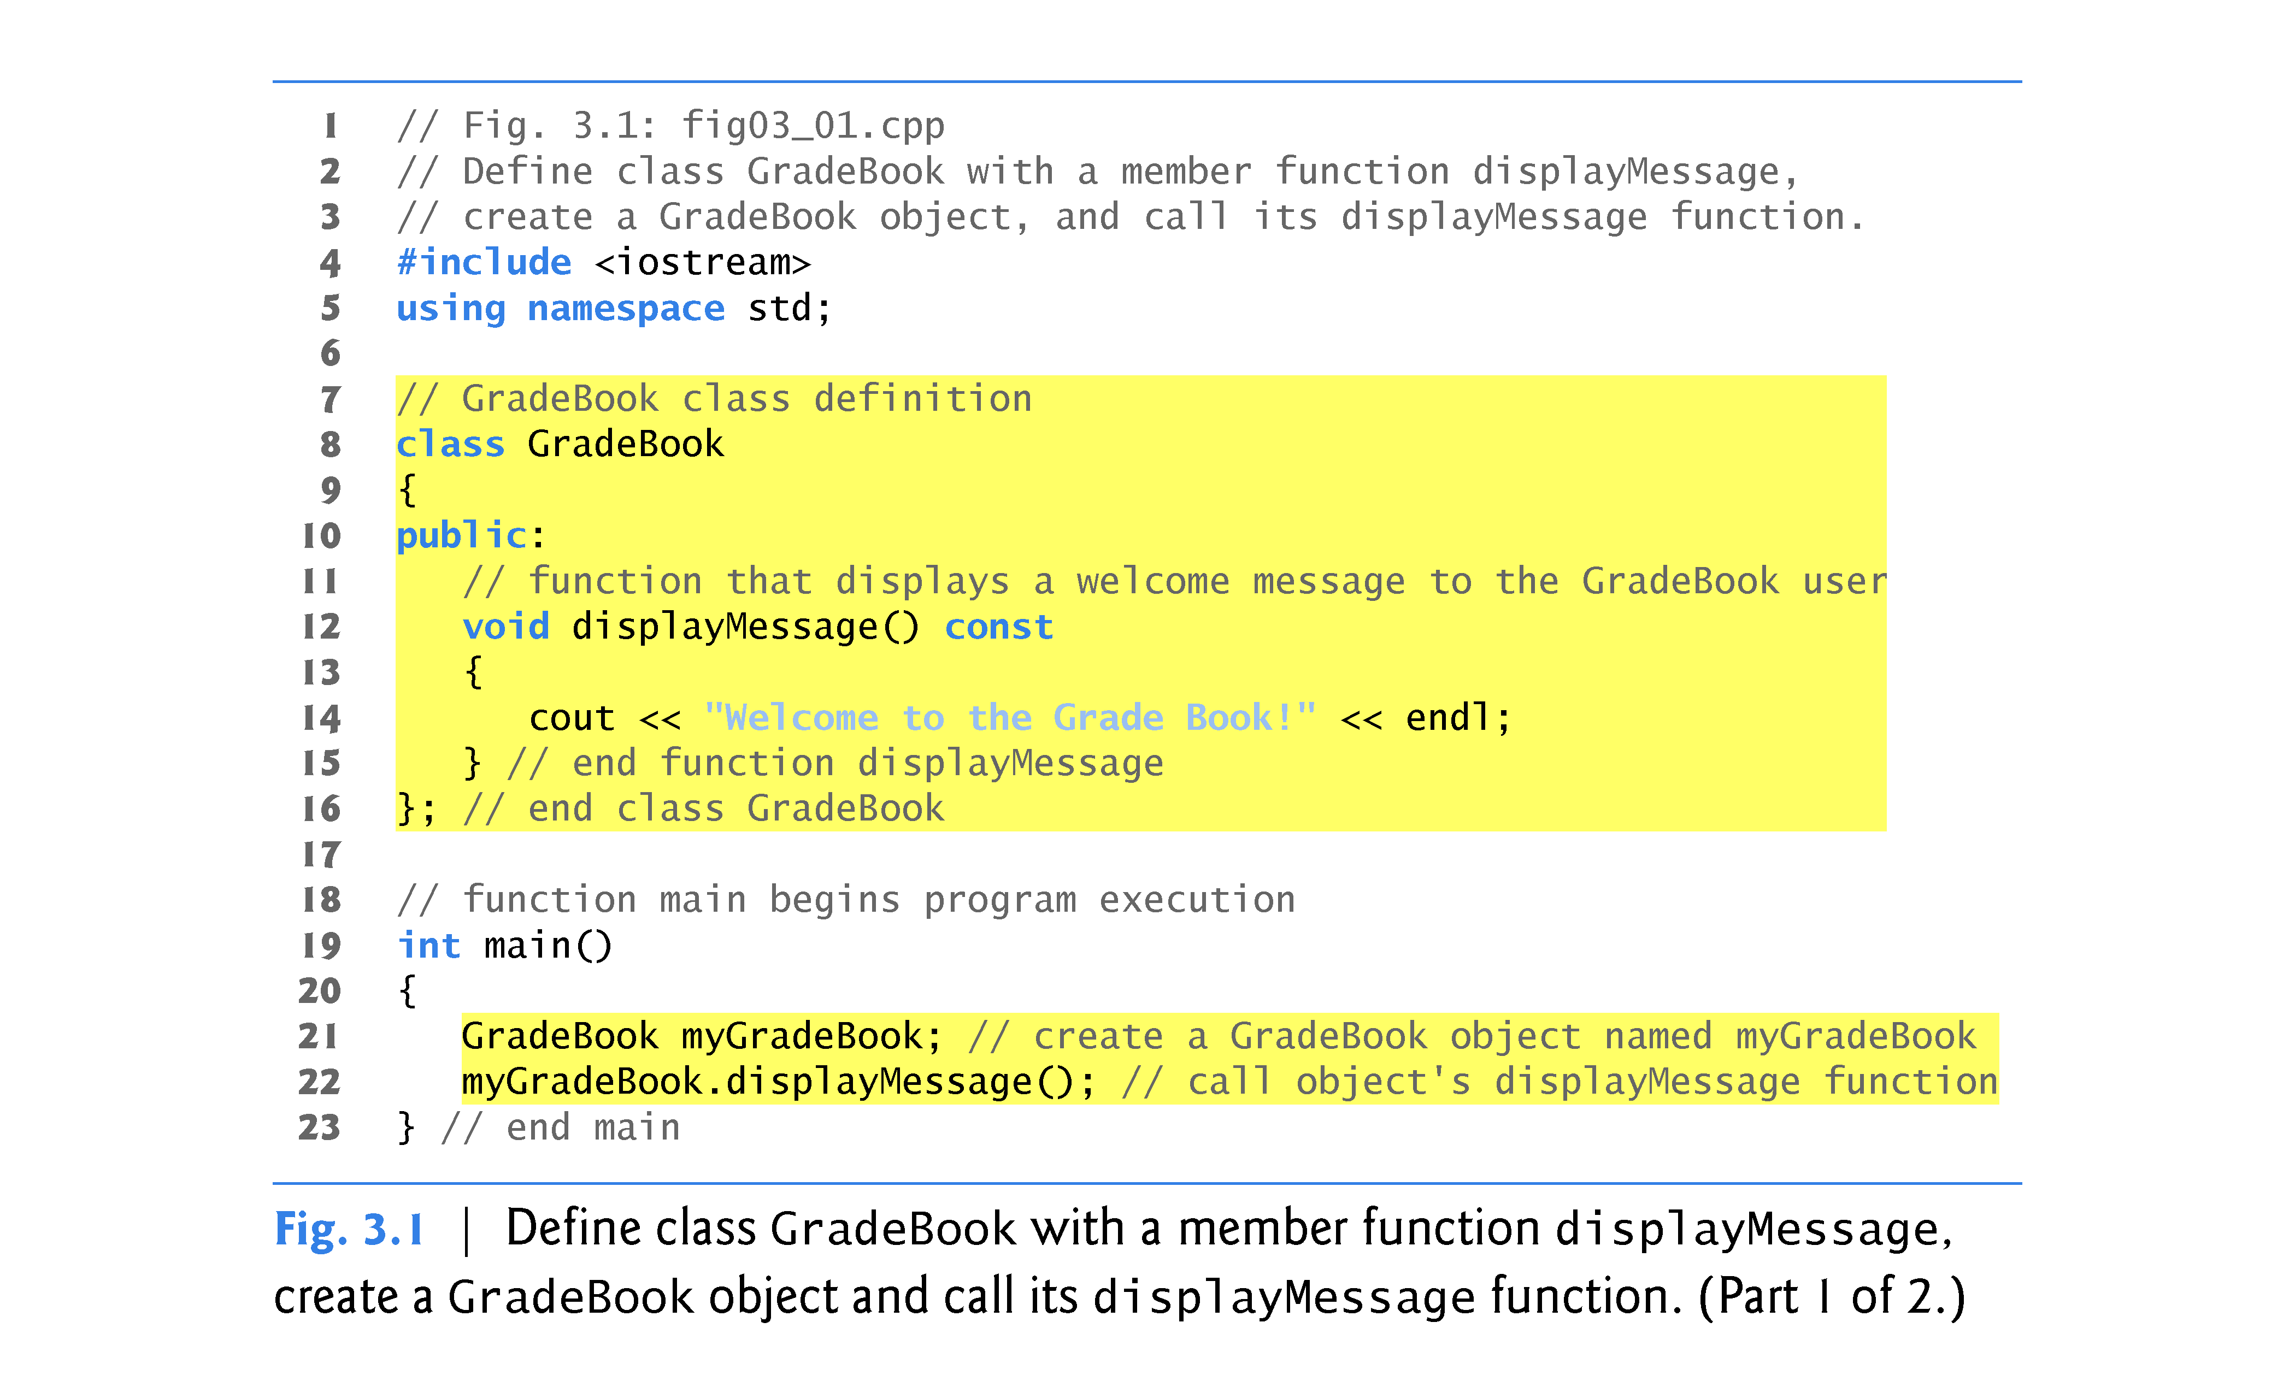

Slide 6
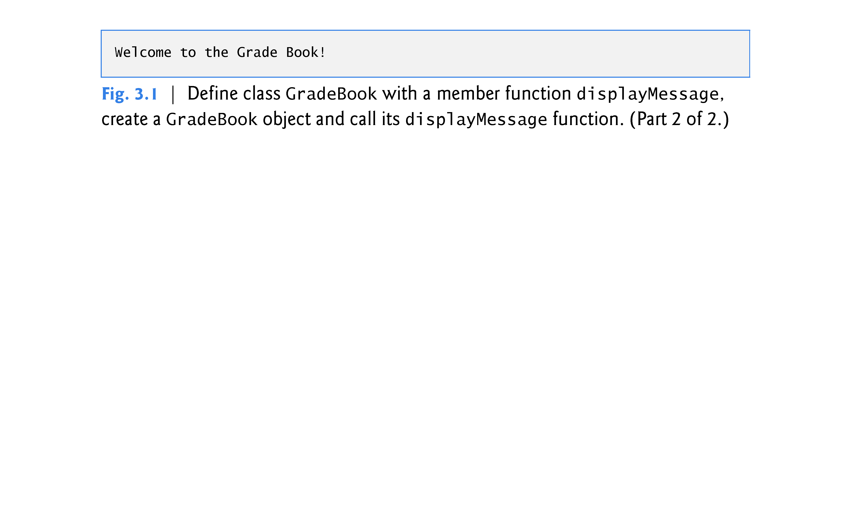

Slide 7
3.2 Defining a Class with a Member Function (cont.)
The GradeBook class definition (lines 8–16) begins with keyword class and contains a member function called displayMessage (lines 12–15) that displays a message on the screen (line 14).
Need to make an object of class GradeBook (line 21) and call its displayMessage member function (line 22) to get line 14 to execute and display the welcome message.
The class definition begins with the keyword class followed by the class name GradeBook.

Slide 8
3.2 Defining a Class with a Member Function (cont.)
By convention, the name of a user-defined class begins with a capital letter, and for readability, each subsequent word in the class name begins with a capital letter.
Often referred to as Pascal case.
The occasional uppercase letters resemble a camel’s humps. More generally, camel case capitalization style allows the first letter to be either lowercase or uppercase
Every class’s body is enclosed in a pair of left and right braces ({ and }), as in lines 9 and 16.
The class definition terminates with a semicolon (line 16).

Slide 9
3.2 Defining a Class with a Member Function (cont.)
Function main is always called automatically when you execute a program.
Most functions do not get called automatically.
You must call member function displayMessage explicitly to tell it to perform its task.
The access-specifier label public: contains the keyword public is an access specifier.
Indicates that the function is “available to the public”—that is, it can be called by other functions in the program (such as main), and by member functions of other classes (if there are any).
Access specifiers are always followed by a colon (:).

Slide 10
3.2 Defining a Class with a Member Function (cont.)
Each function in a program performs a task and may return a value when it completes its task.
When you define a function, you must specify a return type to indicate the type of the value returned by the function when it completes its task.
Keyword void to the left of the function name displayMessage is the function’s return type.
Indicates that displayMessage will not return any data to its calling function when it completes its task.
The name of the member function, displayMessage, follows the return type.
By convention, our function names use the camel case style with a lowercase first letter.
The parentheses after the member function name indicate that it is a function.

Slide 11
3.2 Defining a Class with a Member Function (cont.)
Empty parentheses indicate that a member function does not require additional data to perform its task.
The first line of a function definition is commonly called the function header.
Every function’s body is delimited by left and right braces ({ and }).
The function body contains statements that perform the function’s task.

Slide 12
3.2 Defining a Class with a Member Function (cont.)
Testing Class GradeBook
Typically, you cannot call a member function of a class until you create an object of that class.
First, create an object of class GradeBook called myGradeBook.
The variable’s type is GradeBook.
The compiler does not automatically know what type GradeBook is—it’s a user-defined type.
Tell the compiler what GradeBook is by including the class definition.
Each class you create becomes a new type that can be used to create objects.

Slide 13
3.2 Defining a Class with a Member Function (cont.)
Call the member function displayMessage- by using variable myGradeBook followed by the dot operator (.), the function name display-Message and an empty set of parentheses.
Causes the displayMessage function to perform its task.

Slide 14
3.3 Defining a Member Function with a Parameter
Car analogy
Pressing a car’s gas pedal sends a message to the car to perform a task—make the car go faster.
But how fast should the car accelerate? As you know, the farther down you press the pedal, the faster the car accelerates.
The message to the car includes both the task to perform and additional information that helps the car perform the task.
Additional information that a function needs to perform its task is known as a parameter.
A function call supplies values—called arguments—for each of the function’s parameters.

Slide 15
3.3 Defining a Member Function with a Parameter (cont.)
Fig. 3.3 redefines class GradeBook (lines 9–18) with a display-Message member function (lines 13–17) that displays the course name as part of the welcome message.
The new version of displayMessage requires a parameter (courseName in line 13) that represents the course name to output.
A variable of type string represents a string of characters.
A string is actually an object of the C++ Standard Library class string.
Defined in header file <string> and part of namespace std.
For now, you can think of string variables like variables of other types such as int.
Additional string capabilities in Section 3.9.

Slide 16
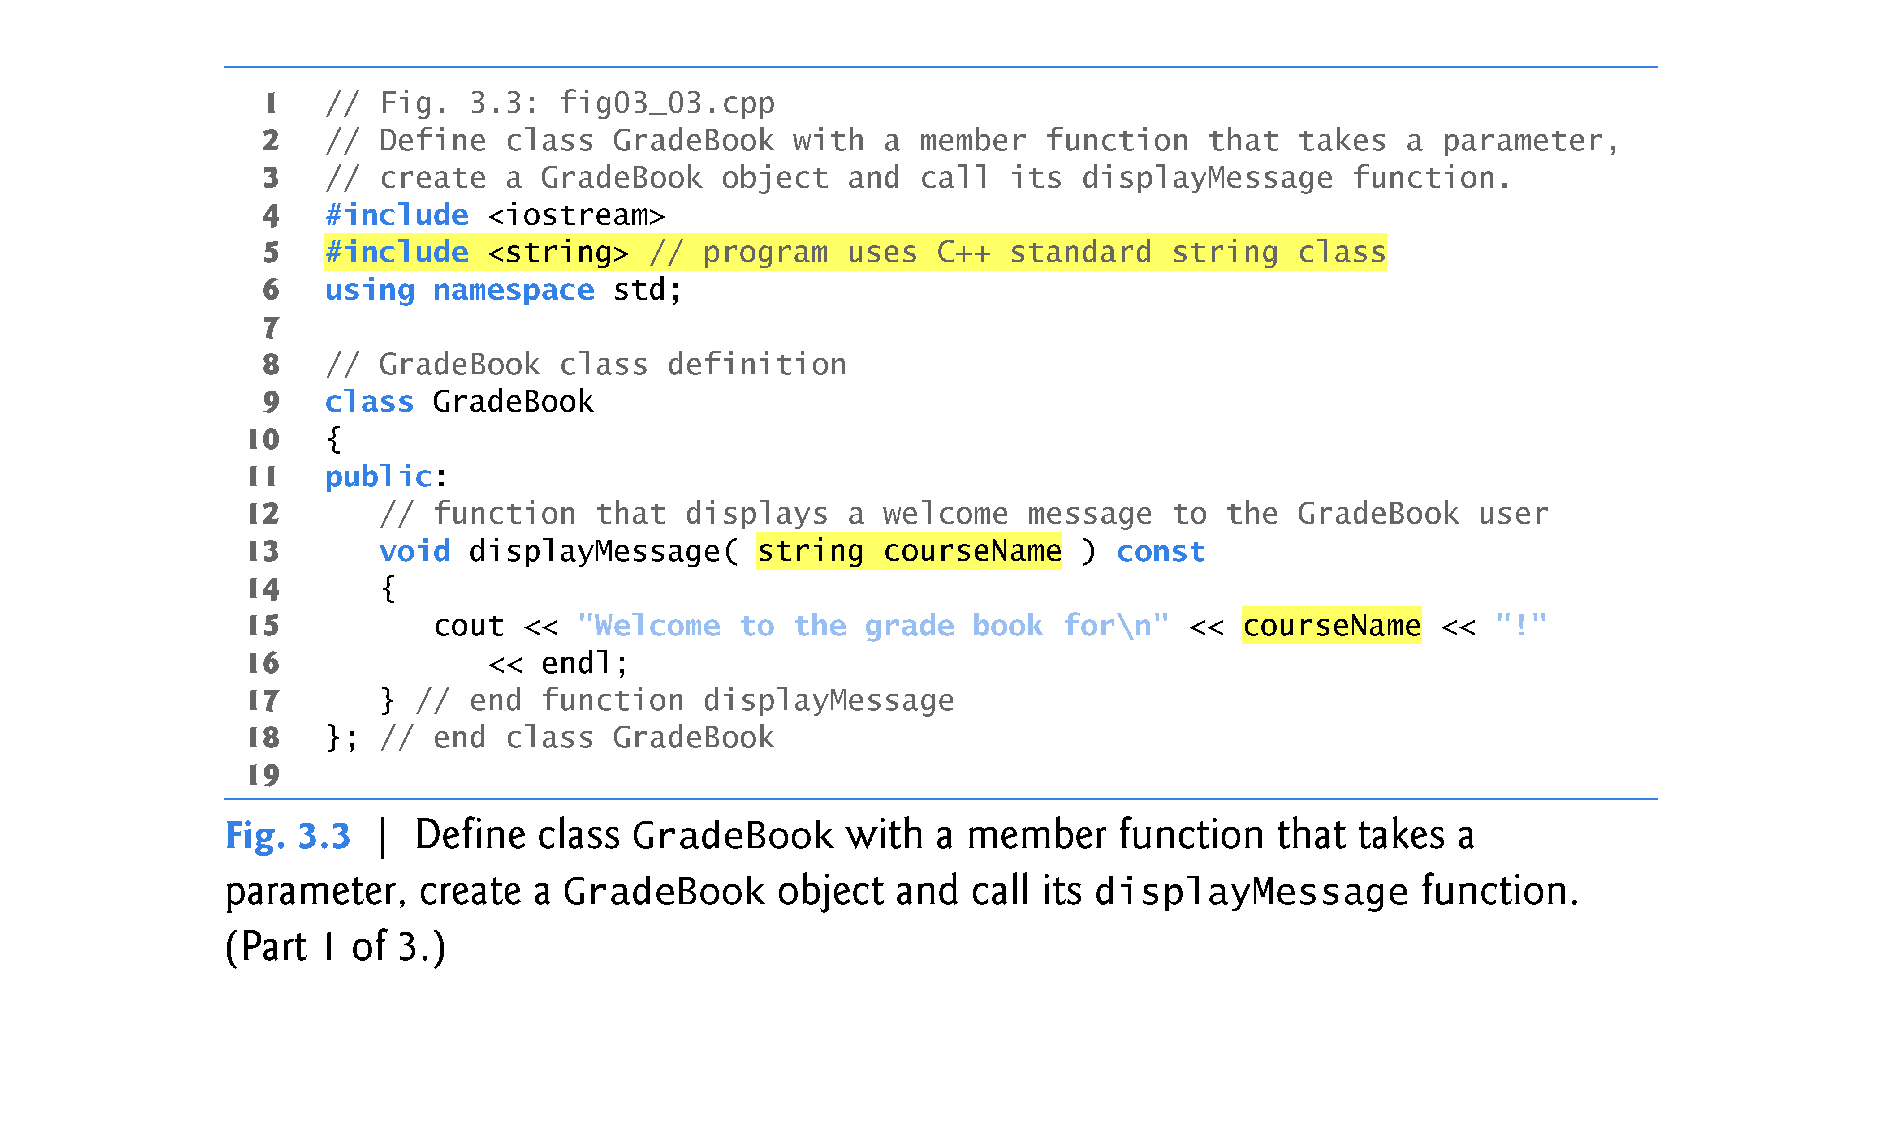

Slide 17
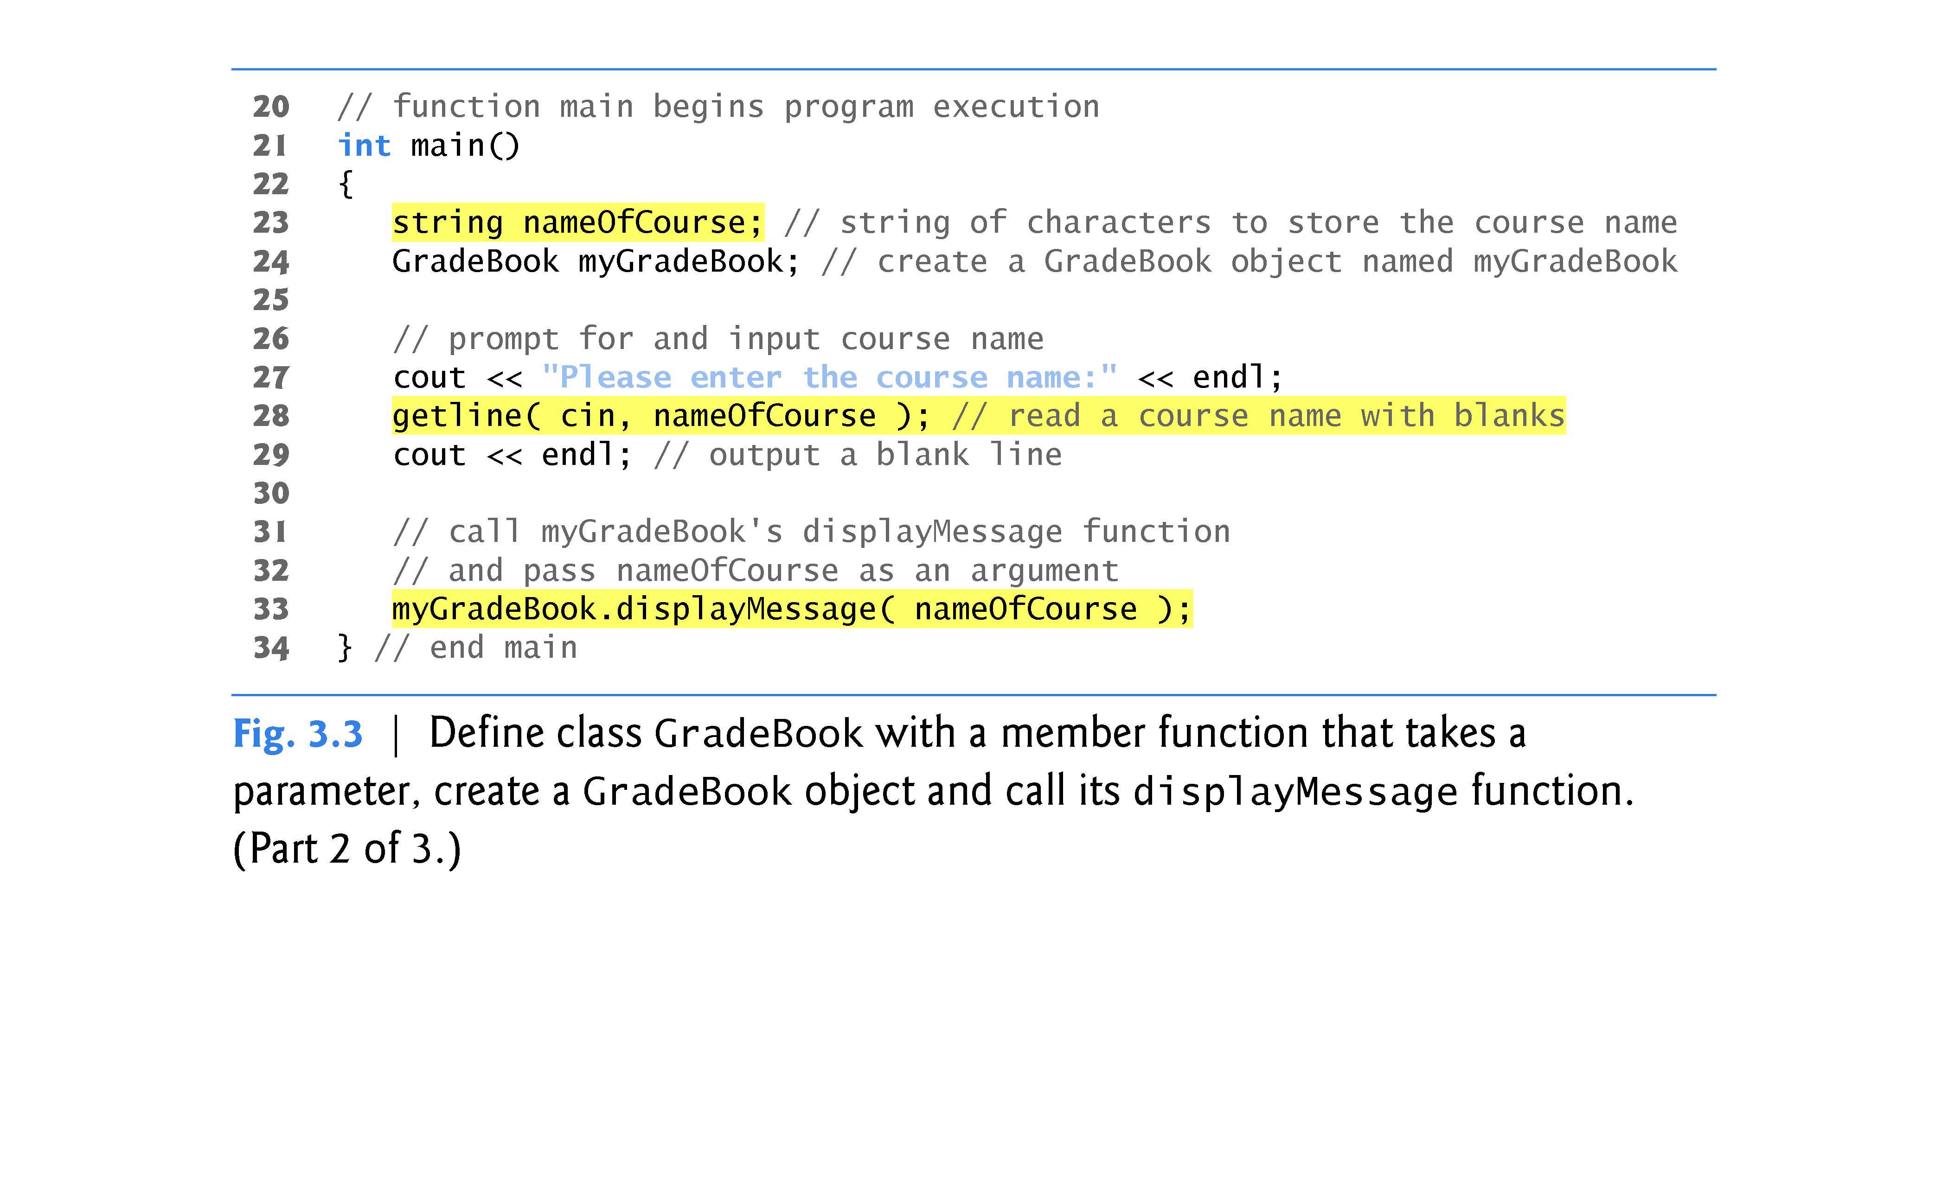

Slide 18
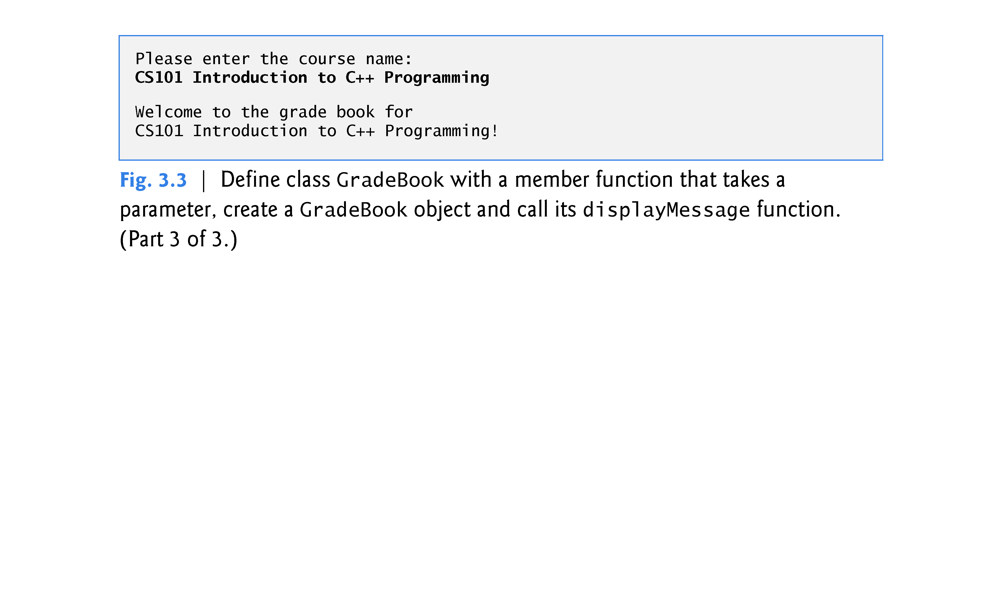

Slide 19
3.3 Defining a Member Function with a Parameter (cont.)
Library function getline reads a line of text into a string.
The function call getline( cin, nameOfCourse ) reads characters (including the space characters that separate the words in the input) from the standard input stream object cin (i.e., the keyboard) until the newline character is encountered, places the characters in the string variable nameOfCourse and discards the newline character.
When you press Enter while entering data, a newline is inserted in the input stream.
The <string> header file must be included in the program to use function getline.

Slide 20
3.3 Defining a Member Function with a Parameter (cont.)
Line 33 calls myGradeBook’s displayMessage member function.
The nameOfCourse variable in parentheses is the argument that is passed to member function displayMessage so that it can perform its task.
The value of variable nameOfCourse in main becomes the value of member function displayMessage’s parameter courseName in line 13.

Slide 21
3.3 Defining a Member Function with a Parameter (cont.)
To specify that a function requires data to perform its task, you place additional information in the function’s parameter list, which is located in the parentheses following the function name.
The parameter list may contain any number of parameters, including none at all to indicate that a function does not require any parameters.
Each parameter must specify a type and an identifier.
A function can specify multiple parameters by separating each parameter from the next with a comma.
The number and order of arguments in a function call must match the number and order of parameters in the parameter list of the called member function’s header.
Tthe argument types in the function call must be consistent with the types of the corresponding parameters in the function header.

Slide 22
3.4 Data Members, set Member Functions and get Member Functions
Variables declared in a function definition’s body are known as local variables and can be used only from the line of their declaration in the function to the closing right brace (}) of the block in which they’re declared.
A local variable must be declared before it can be used in a function.
A local variable cannot be accessed outside the function in which it’s declared.
When a function terminates, the values of its local variables are lost.

Slide 23
3.4 Data Members, set Member Functions and get Member Functions (Cont.)
An object has attributes that are carried with it as it’s used in a program.
Such attributes exist throughout the life of the object.
A class normally consists of one or more member functions that manipulate the attributes that belong to a particular object of the class.
Attributes are represented as variables in a class definition.
Such variables are called data members and are declared inside a class definition but outside the bodies of the class’s member-function definitions.
Each object of a class maintains its own attributes in memory.

Slide 24
3.4 Data Members, set Member Functions and get Member Functions (Cont.)
A typical instructor teaches several courses, each with its own course name.
A variable that is declared in the class definition but outside the bodies of the class’s member-function definitions is a data member.
Every instance (i.e., object) of a class contains each of the class’s data members.
A benefit of making a variable a data member is that all the member functions of the class can manipulate any data members that appear in the class definition.

Slide 25
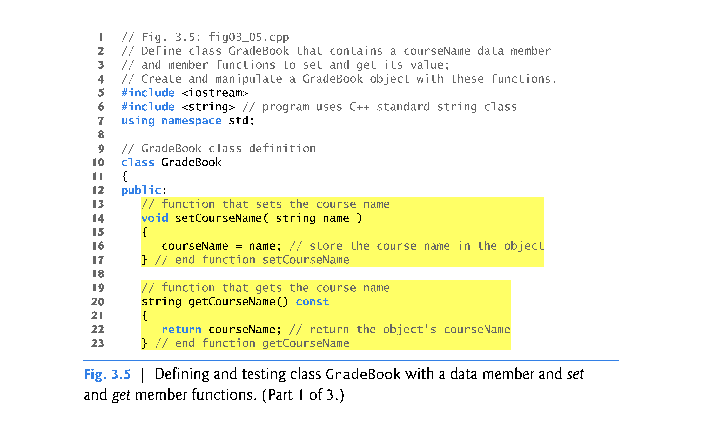

Slide 26
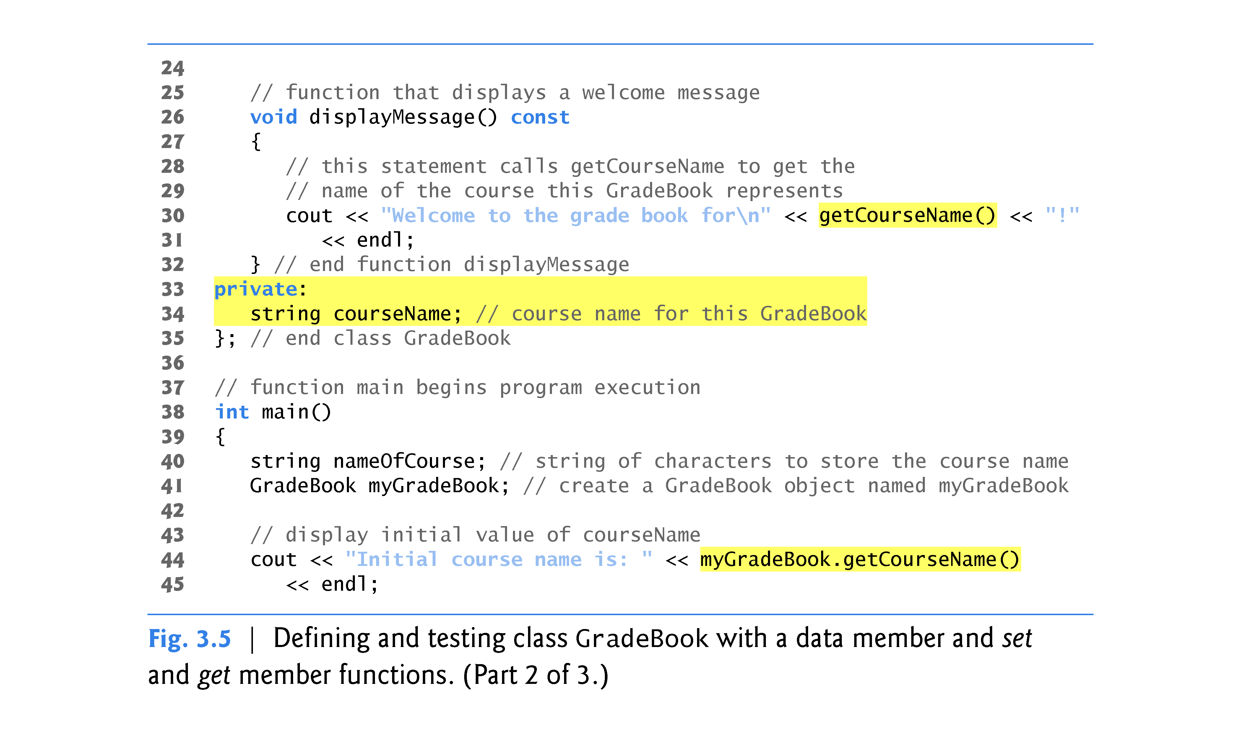

Slide 27
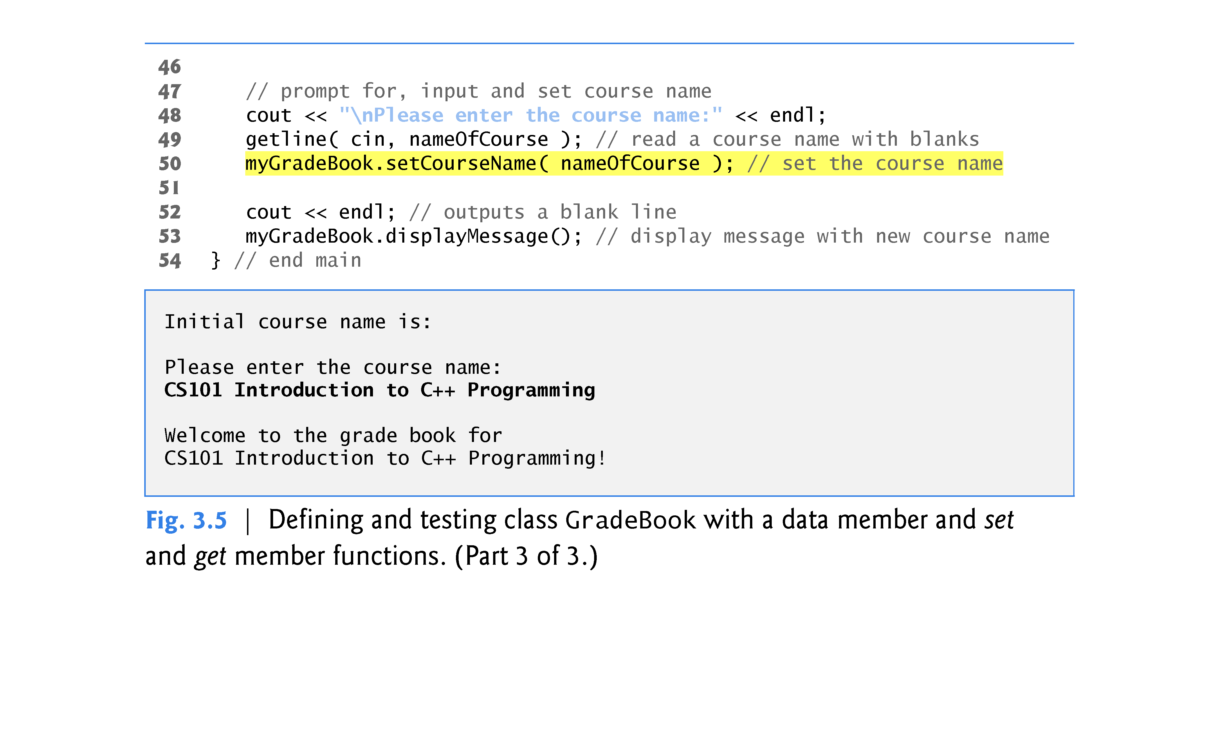

Slide 28
3.4 Data Members, set Member Functions and get Member Functions (Cont.)
Most data-member declarations appear after the access-specifier label private:
Like public, keyword private is an access specifier.
Variables or functions declared after access specifier private (and before the next access specifier) are accessible only to member functions of the class for which they’re declared.
The default access for class members is private so all members after the class header and before the first access specifier are private.
The access specifiers public and private may be repeated, but this is unnecessary and can be confusing.

Slide 29
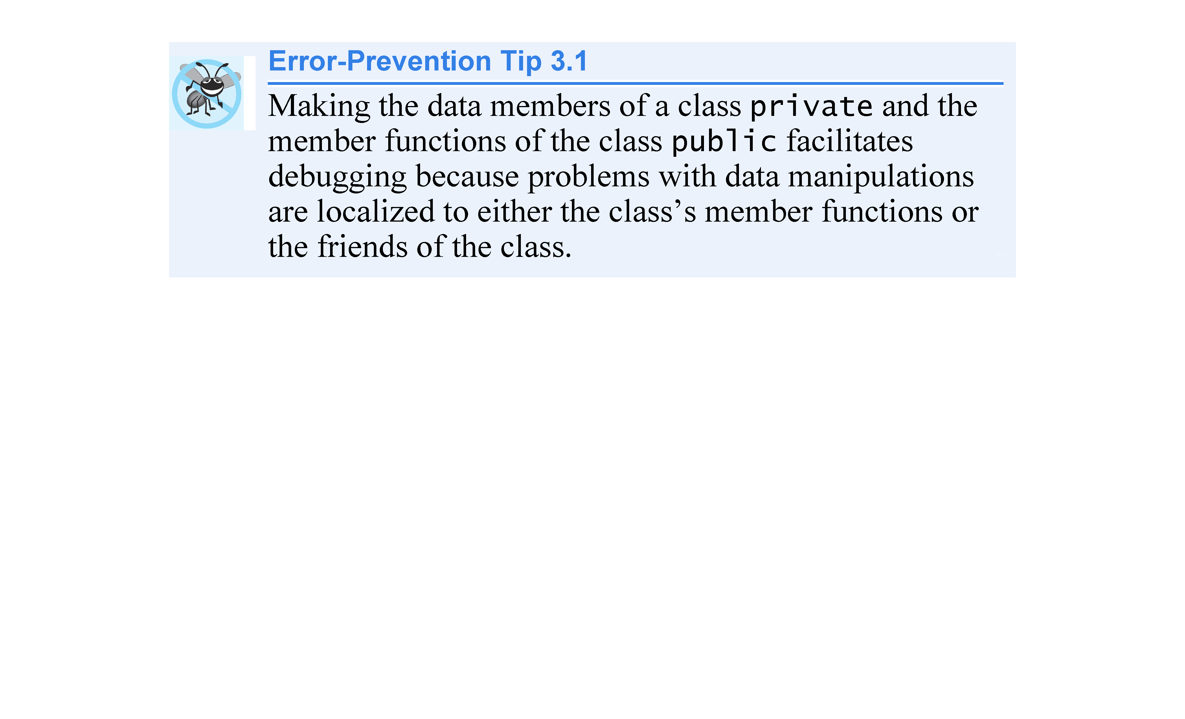

Slide 30
3.4 Data Members, set Member Functions and get Member Functions (Cont.)
Declaring data members with access specifier private is known as data hiding.
When a program creates (instantiates) an object, its data members are encapsulated (hidden) in the object and can be accessed only by member functions of the object’s class.

Slide 31
3.4 Data Members, set Member Functions and get Member Functions (Cont.)
In this example, setCourseName does not attempt to validate the course name—i.e., the function does not check that the course name adheres to any particular format or follows any other rules regarding what a “valid” course name looks like.
Suppose, for instance, that a university can print student transcripts containing course names of only 25 characters or fewer.
In this case, we might want class GradeBook to ensure that its data member courseName never contains more than 25 characters.
We discuss basic validation techniques in Section 3.9.
When a function that specifies a return type other than void is called and completes its task, the function uses a return statement to return a result to its calling function.

Slide 32
3.4 Data Members, set Member Functions and get Member Functions (Cont.)
Member function displayMessage (lines 26–32) does not return any data when it completes its task, so its return type is void.
The function does not receive parameters, so its parameter list is empty.
Line 30 calls member function getCourseName to obtain the value of courseName.
Member function displayMessage could also access data member courseName directly, just as member functions setCourseName and getCourseName do.
By default, the initial value of a string is the so-called empty string, i.e., a string that does not contain any characters.
Nothing appears on the screen when an empty string is displayed.

Slide 33
3.4 Data Members, set Member Functions and get Member Functions (Cont.)
A client of an object—that is, any class or function that calls the object’s member functions from outside the object—calls the class’s public member functions to request the class’s services for particular objects of the class.
This is why the statements in main call member functions setCourseName, getCourseName and displayMessage on a GradeBook object.
Classes often provide public member functions to allow clients of the class to set (i.e., assign values to) or get (i.e., obtain the values of) private data members.
These member function names need not begin with set or get, but this naming convention is common.
Set functions are also sometimes called mutators (because they mutate, or change, values), and get functions are also sometimes called accessors (because they access values).

Slide 34
3.5 Initializing Objects with Constructors
Each class can provide one or more constructors that can be used to initialize an object of the class when the object is created.
A constructor is a special member function that must be defined with the same name as the class, so that the compiler can distinguish it from the class’s other member functions.
An important difference between constructors and other functions is that constructors cannot return values, so they cannot specify a return type (not even void).
Normally, constructors are declared public.

Slide 35
3.5 Initializing Objects with Constructors (cont.)
C++ automatically calls a constructor for each object that is created, which helps ensure that objects are initialized properly before they’re used in a program.
The constructor call occurs when the object is created.
If a class does not explicitly include constructors, the compiler provides a default constructor with no parameters.

Slide 36
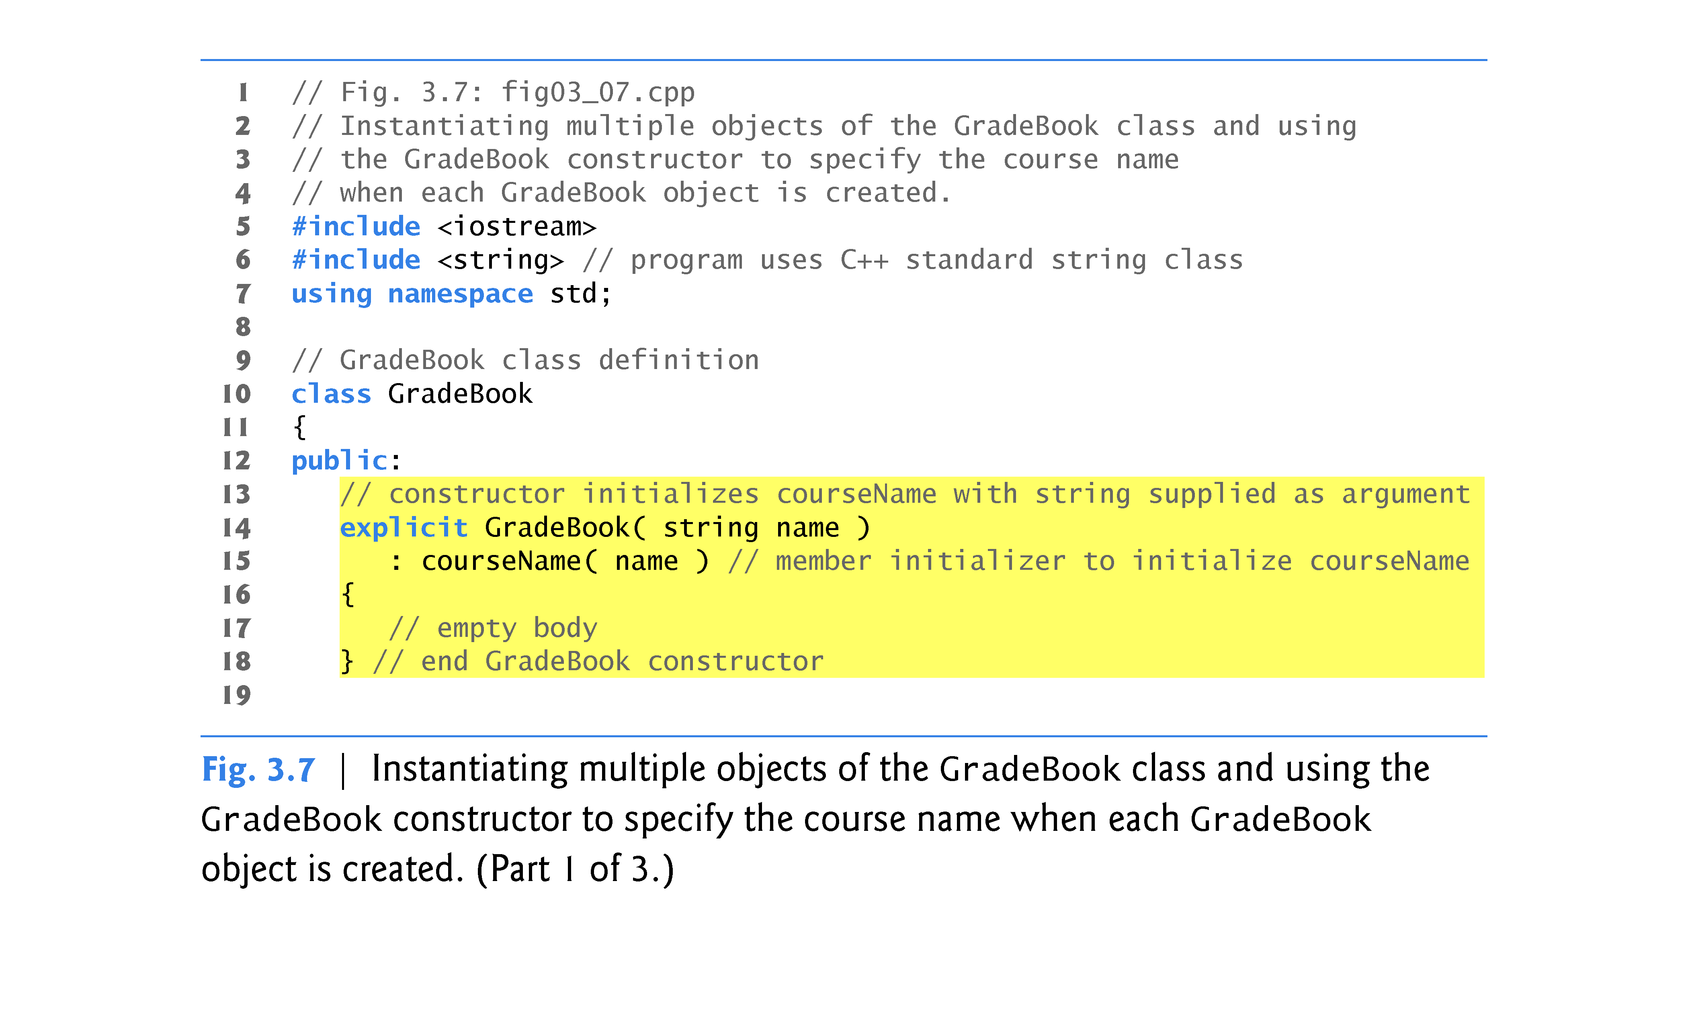

Slide 37
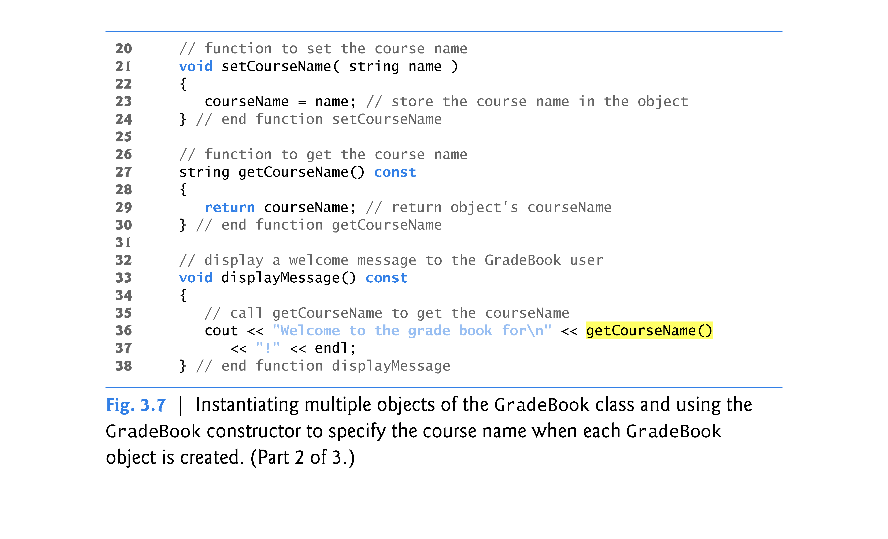

Slide 38
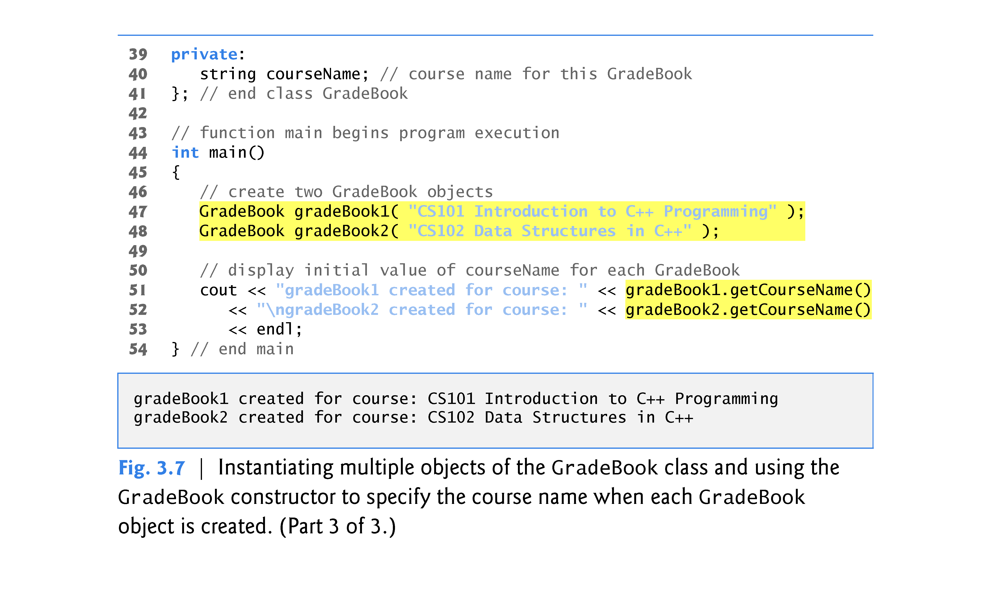

Slide 39
3.5 Initializing Objects with Constructors (cont.)
A constructor specifies in its parameter list the data it requires to perform its task.
When you create a new object, you place this data in the parentheses that follow the object name.
The constructor uses a member-initializer list (line 15) to initialize the courseName data member with the value of the constructor’s parameter name.
Member initializers appear between a constructor’s parameter list and the left brace that begins the constructor’s body.
The member initializer list is separated from the parameter list with a colon (:).

Slide 40
3.5 Initializing Objects with Constructors (cont.)
A member initializer consists of a data member’s variable name followed by parentheses containing the member’s initial value.
In this example, courseName is initialized with the value of the parameter name.
If a class contains more than one data member, each data member’s initializer is separated from the next by a comma.
The member initializer list executes before the body of the constructor executes.

Slide 41
3.5 Initializing Objects with Constructors (cont.)
Line 47 creates and initializes a GradeBook object called gradeBook1.
When this line executes, the GradeBook constructor (lines 14–18) is called with the argument "CS101 Introduction to C++ Programming" to initialize gradeBook1’s course name.
Line 48 repeats this process for the GradeBook object called gradeBook2, this time passing the argument "CS102 Data Structures in C++" to initialize gradeBook2’s course name.

Slide 42
3.5 Initializing Objects with Constructors (cont.)
Any constructor that takes no arguments is called a default constructor.
A class gets a default constructor in one of several ways:
The compiler implicitly creates a default constructor in every class that does not have any user-defined constructors. The default constructor does not initialize the class’s data members, but does call the default constructor for each data member that is an object of another class. An uninitialized variable contains an undefined (“garbage”) value.
You explicitly define a constructor that takes no arguments. Such a default constructor will call the default constructor for each data member that is an object of another class and will perform additional initialization specified by you.
If you define any constructors with arguments, C++ will not implicitly create a default constructor for that class.

Slide 43
3.6 Placing a Class in a Separate File for Reusability
One of the benefits of creating class definitions is that, when packaged properly, our classes can be reused by programmers—potentially worldwide.
Programmers who wish to use our GradeBook class cannot simply include the file from Fig. 3.7 in another program.
As you learned in Chapter 2, function main begins the execution of every program, and every program must have exactly one main function.

Slide 44
3.6 Placing a Class in a Separate File for Reusability (cont.)
Each of the previous examples in the chapter consists of a single .cpp file, also known as a source-code file, that contains a GradeBook class definition and a main function.
When building an object-oriented C++ program, it’s customary to define reusable source code (such as a class) in a file that by convention has a .h filename extension—known as a header.
Programs use #include preprocessing directives to include header files and take advantage of reusable software components.

Slide 45
3.6 Placing a Class in a Separate File for Reusability (cont.)
Our next example separates the code from Fig. 3.7 into two files—GradeBook.h (Fig. 3.9) and fig03_10.cpp (Fig. 3.10).
As you look at the header file in Fig. 3.9, notice that it contains only the GradeBook class definition (lines 7–38) and the headers on which the class depends.
The main function that uses class GradeBook is defined in the source-code file fig03_10.cpp (Fig. 3.10) in lines 8–18.
To help you prepare for the larger programs you’ll encounter later in this book and in industry, we often use a separate source-code file containing function main to test our classes (this is called a driver program).

Slide 46
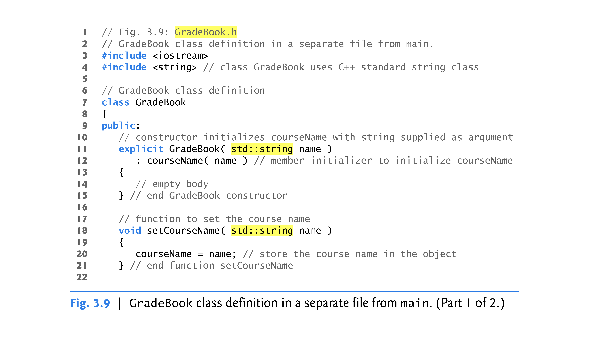

Slide 47
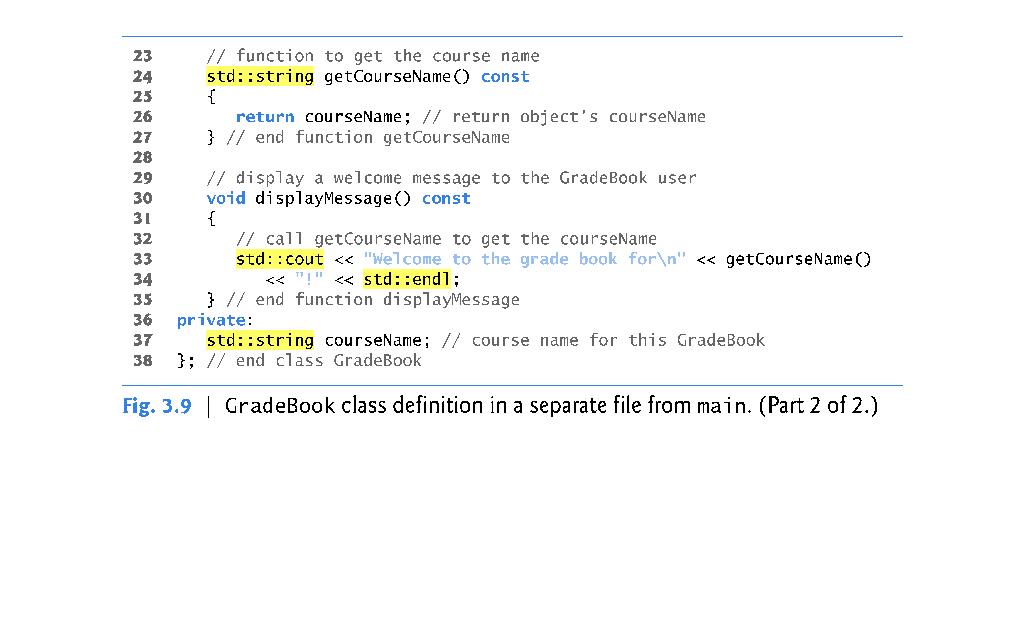

Slide 48
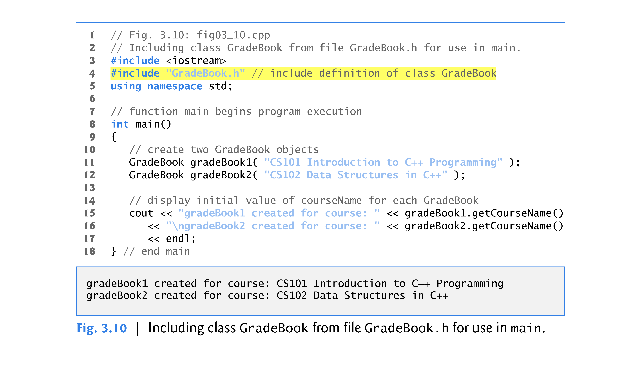

Slide 49
3.6 Placing a Class in a Separate File for Reusability (cont.)
Throughout the header (Fig. 3.9), we use std:: when referring to string (lines 11, 18, 24 and 37), cout (line 33) and endl (line 34).
Headers should never contain using directives or using declarations (Section 2.7).
To test class GradeBook (defined in Fig. 3.9), you must write a separate source-code file containing a main function (such as Fig. 3.10) that instantiates and uses objects of the class.

Slide 50
3.6 Placing a Class in a Separate File for Reusability (cont.)
To help the compiler understand how to use a class, we must explicitly provide the compiler with the class’s definition
That’s why, for example, to use type string, a program must include the <string> header file.
This enables the compiler to determine the amount of memory that it must reserve for each object of the class and ensure that a program calls the class’s member functions correctly.

Slide 51
3.6 Placing a Class in a Separate File for Reusability (cont.)
The compiler creates only one copy of the class’s member functions and shares that copy among all the class’s objects.
Each object, of course, needs its own data members, because their contents can vary among objects.
The member-function code, however, is not modifiable, so it can be shared among all objects of the class.
Therefore, the size of an object depends on the amount of memory required to store the class’s data members.
By including GradeBook.h in line 4, we give the compiler access to the information it needs to determine the size of a GradeBook object and to determine whether objects of the class are used correctly.

Slide 52
3.6 Placing a Class in a Separate File for Reusability (cont.)
A #include directive instructs the C++ preprocessor to replace the directive with a copy of the contents of GradeBook.h before the program is compiled.
When the source-code file fig03_10.cpp is compiled, it now contains the GradeBook class definition (because of the #include), and the compiler is able to determine how to create GradeBook objects and see that their member functions are called correctly.
Now that the class definition is in a header file (without a main function), we can include that header in any program that needs to reuse our GradeBook class.

Slide 53
3.6 Placing a Class in a Separate File for Reusability (cont.)
Notice that the name of the GradeBook.h header file in line 4 of Fig. 3.10 is enclosed in quotes (" ") rather than angle brackets (< >).
Normally, a program’s source-code files and user-defined header files are placed in the same directory.
When the preprocessor encounters a header file name in quotes, it attempts to locate the header file in the same directory as the file in which the #include directive appears.
If the preprocessor cannot find the header file in that directory, it searches for it in the same location(s) as the C++ Standard Library header files.
When the preprocessor encounters a header file name in angle brackets (e.g., <iostream>), it assumes that the header is part of the C++ Standard Library and does not look in the directory of the program that is being preprocessed.

Slide 54
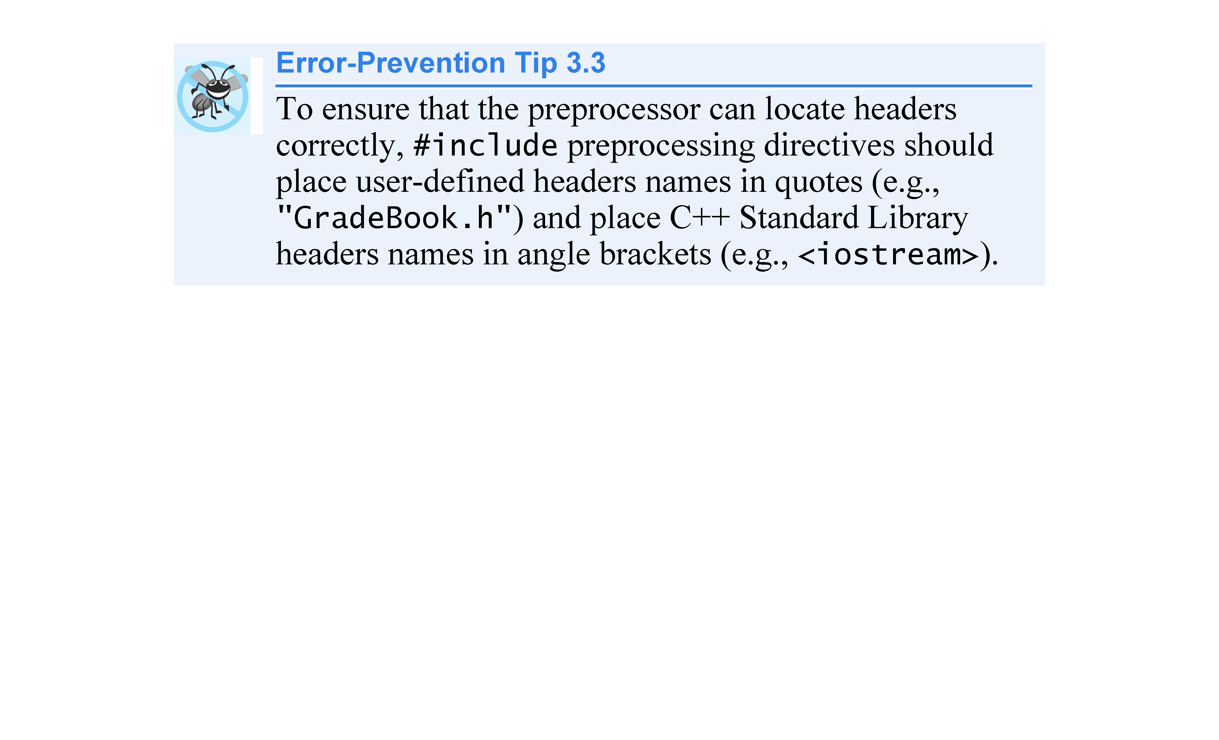

Slide 55
3.6 Placing a Class in a Separate File for Reusability (cont.)
Placing a class definition in a header file reveals the entire implementation of the class to the class’s clients.
Conventional software engineering wisdom says that to use an object of a class, the client code needs to know only what member functions to call, what arguments to provide to each member function and what return type to expect from each member function.
The client code does not need to know how those functions are implemented.
If client code does know how a class is implemented, the client-code programmer might write client code based on the class’s implementation details.
Ideally, if that implementation changes, the class’s clients should not have to change.
Hiding the class’s implementation details makes it easier to change the class’s implementation while minimizing, and hopefully eliminating, changes to client code.

Slide 56
3.7 Separating Interface from Implementation
Interfaces define and standardize the ways in which things such as people and systems interact with one another.
The interface of a class describes what services a class’s clients can use and how to request those services, but not how the class carries out the services.
A class’s public interface consists of the class’s public member functions (also known as the class’s public services).

Slide 57
3.7 Separating Interface from Implementation (cont.)
In our prior examples, each class definition contained the complete definitions of the class’s public member functions and the declarations of its private data members.
It’s better software engineering to define member functions outside the class definition, so that their implementation details can be hidden from the client code.
Ensures that you do not write client code that depends on the class’s implementation details.
The program of Figs. 3.11–3.13 separates class GradeBook’s interface from its implementation by splitting the class definition of Fig. 3.9 into two files—the header file GradeBook.h (Fig. 3.11) in which class GradeBook is defined, and the source-code file GradeBook.cpp (Fig. 3.12) in which GradeBook’s member functions are defined.

Slide 58
3.7 Separating Interface from Implementation (cont.)
By convention, member-function definitions are placed in a source-code file of the same base name (e.g., GradeBook) as the class’s header file but with a .cpp filename extension.
Figure 3.14 shows how this three-file program is compiled from the perspectives of the GradeBook class programmer and the client-code programmer—we’ll explain this figure in detail.

Slide 59
3.7 Separating Interface from Implementation (cont.)
Header file GradeBook.h (Fig. 3.11) is similar to the one in Fig. 3.9, but the function definitions in Fig. 3.9 are replaced here with function prototypes (lines 11–14) that describe the class’s public interface without revealing the class’s member-function implementations.
A function prototype is a declaration of a function that tells the compiler the function’s name, its return type and the types of its parameters.
Including the header file GradeBook.h in the client code (line 5 of Fig. 3.13) provides the compiler with the information it needs to ensure that the client code calls the member functions of class GradeBook correctly.

Slide 60
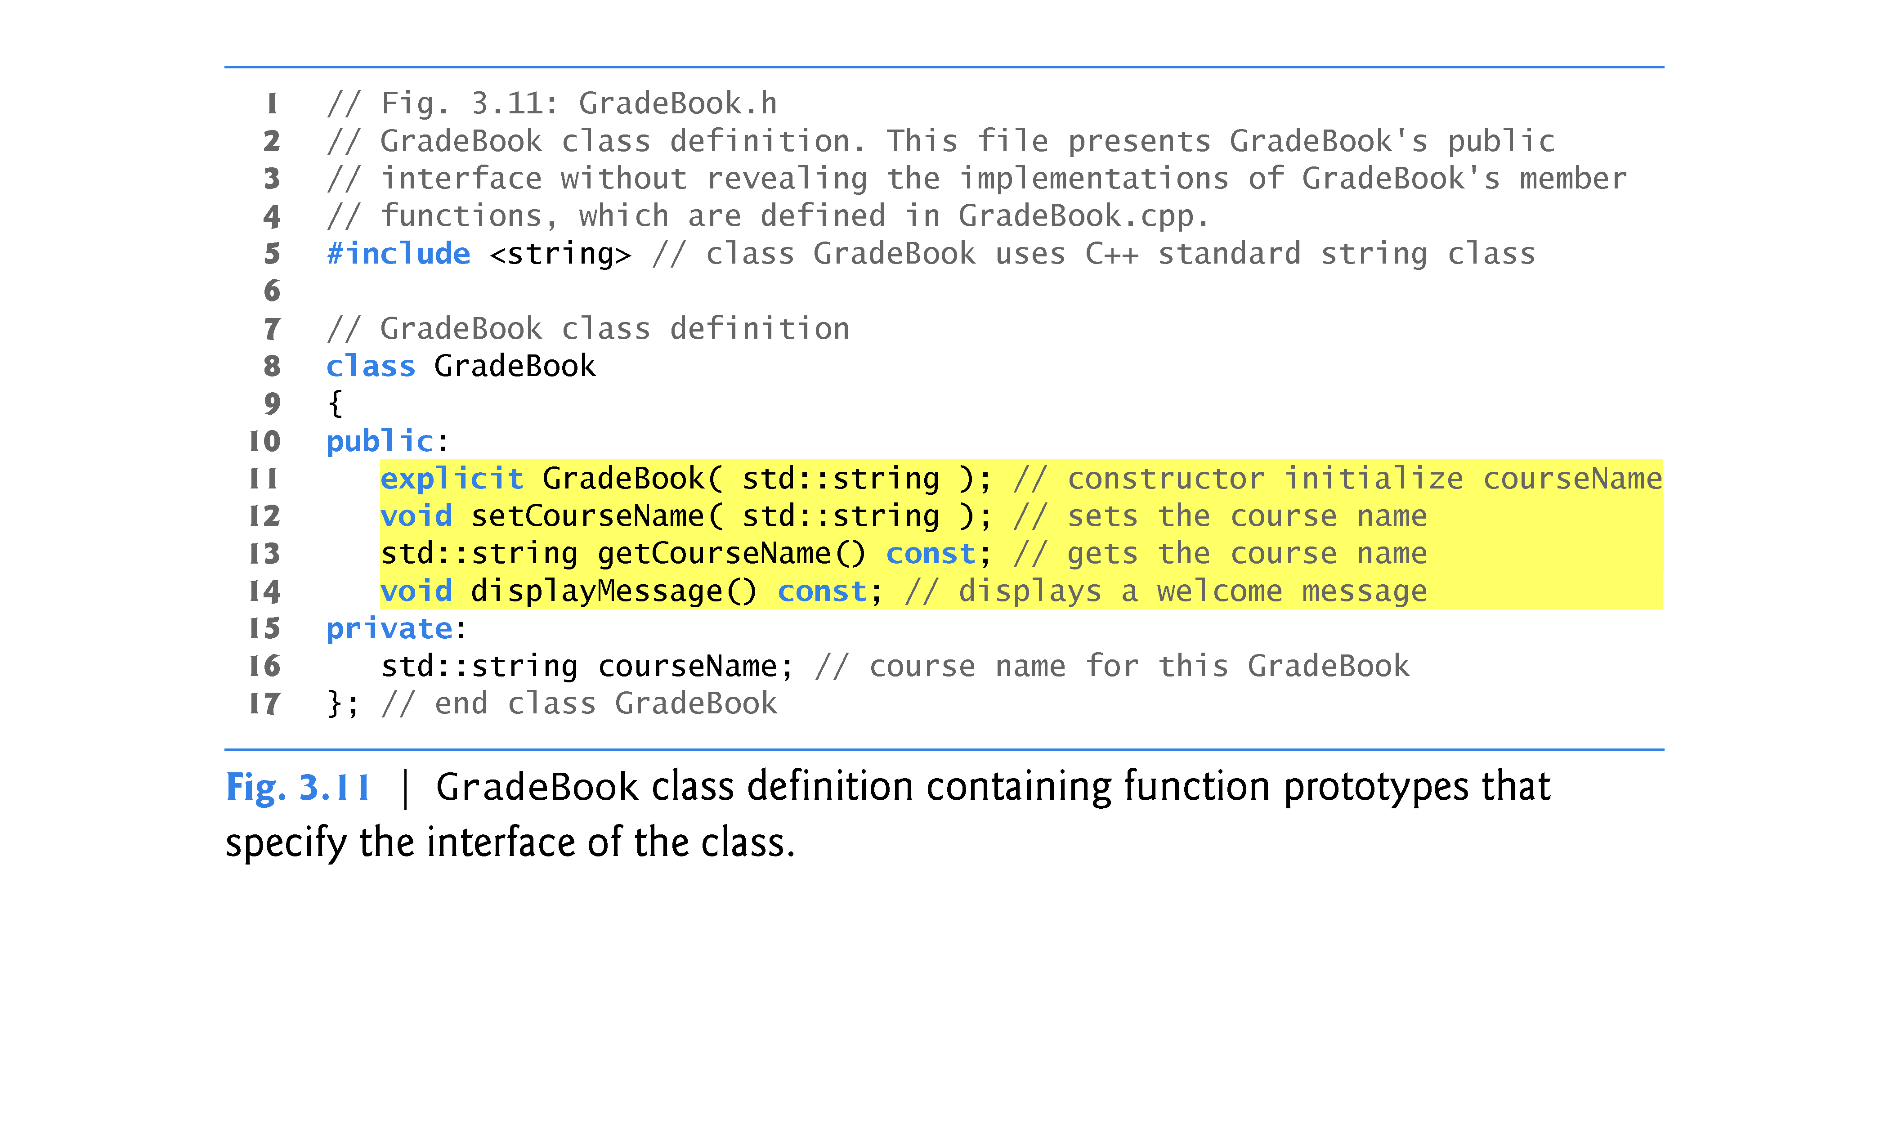

Slide 61
3.7 Separating Interface from Implementation (cont.)
Source-code file GradeBook.cpp (Fig. 3.12) defines class GradeBook’s member functions, which were declared in lines 11–14 of Fig. 3.11.
Each member-function name (lines 9, 16, 22 and 28) is preceded by the class name and ::, which is known as the scope resolution operator.
This “ties” each member function to the (now separate) GradeBook class definition (Fig. 3.11), which declares the class’s member functions and data members.

Slide 62
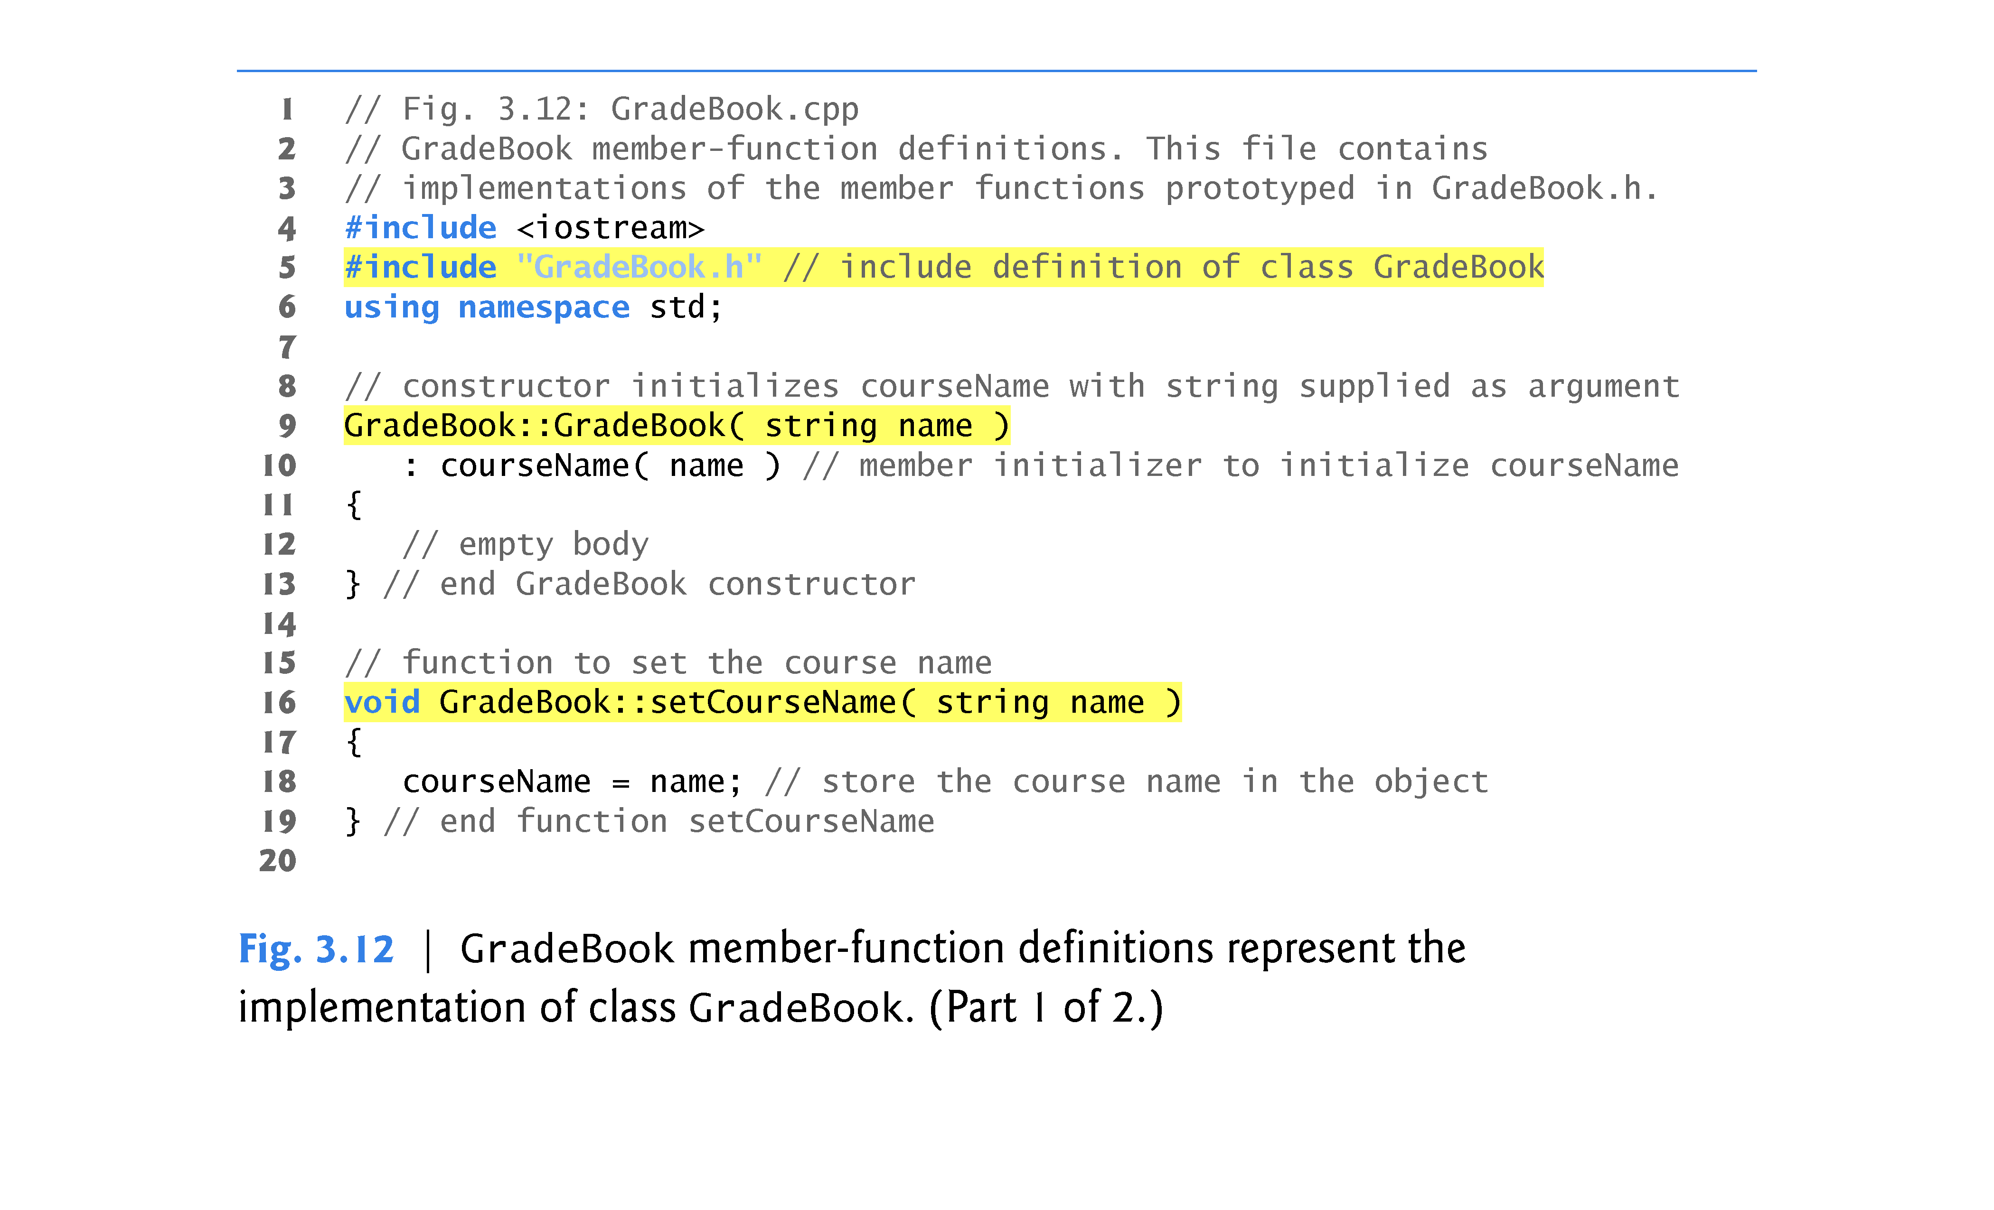

Slide 63
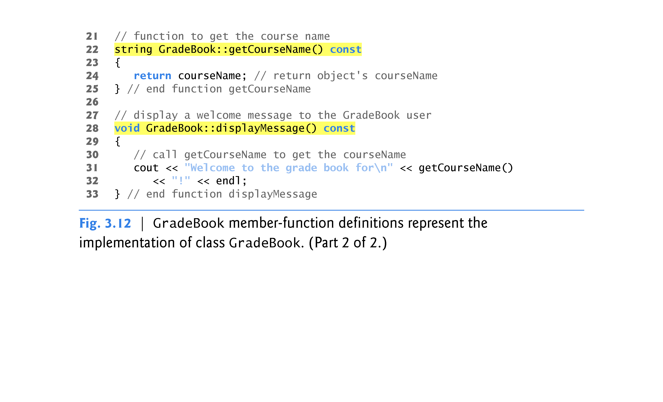

Slide 64
3.7 Separating Interface from Implementation (cont.)
To indicate that the member functions in GradeBook.cpp are part of class GradeBook, we must first include the GradeBook.h header file (line 5 of Fig. 3.12).
This allows us to access the class name GradeBook in the GradeBook.cpp file.
When compiling GradeBook.cpp, the compiler uses the information in GradeBook.h to ensure that
the first line of each member function matches its prototype in the GradeBook.h file, and that
each member function knows about the class’s data members and other member functions

Slide 65
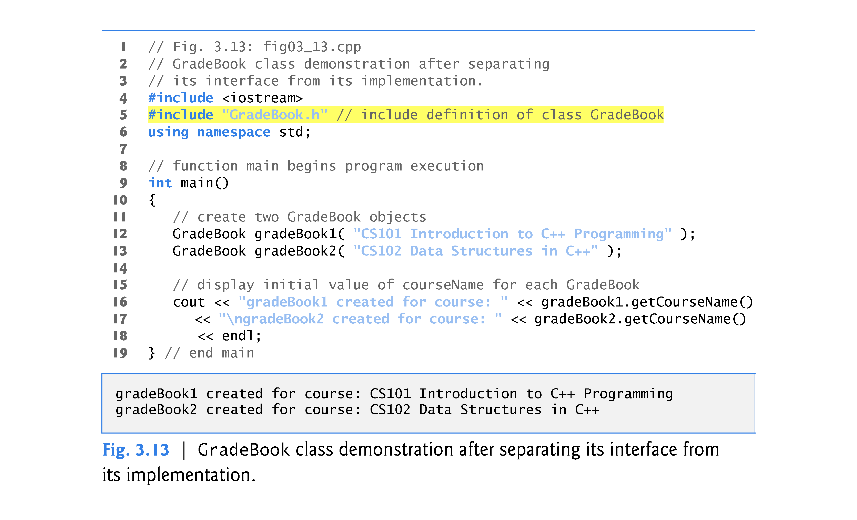

Slide 66
3.7 Separating Interface from Implementation (cont.)
Before executing this program, the source-code files in Fig. 3.12 and Fig. 3.13 must both be compiled, then linked together—that is, the member-function calls in the client code need to be tied to the implementations of the class’s member functions—a job performed by the linker.
The diagram in Fig. 3.14 shows the compilation and linking process that results in an executable GradeBook application that can be used by instructors.

Slide 67
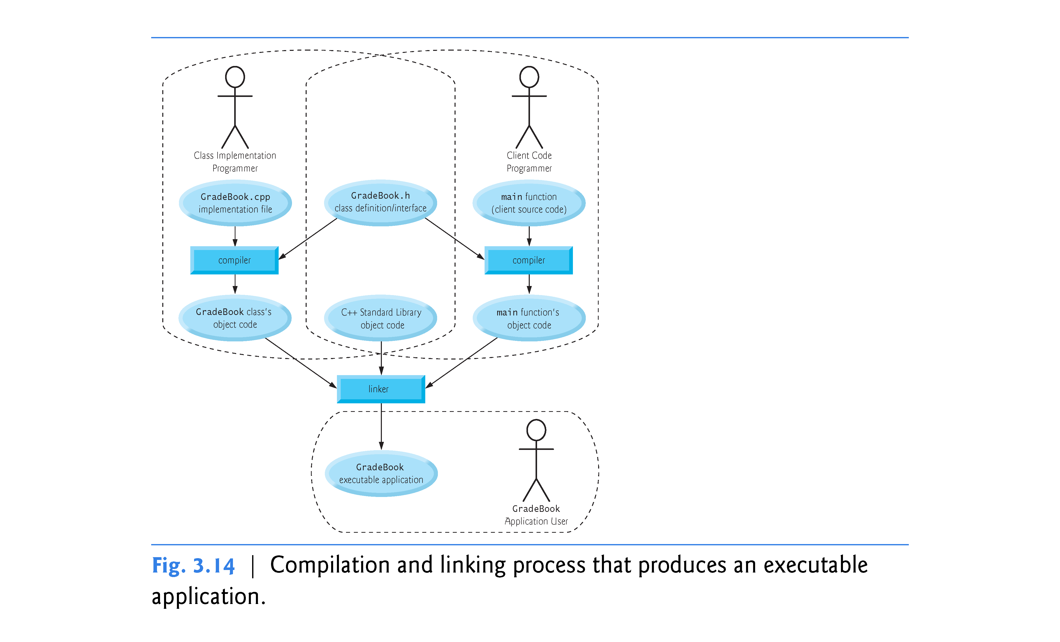

Slide 68
3.8 Validating Data with set Functions
The program of Figs. 3.15–3.17 enhances class GradeBook’s member function setCourseName to perform validation (also known as validity checking).
Since the interface of the clas remains unchanged, clients of this class need not be changed when the definition of member function setCourseName is modified.
This enables clients to take advantage of the improved GradeBook class simply by linking the client code to the updated GradeBook’s object code.

Slide 69
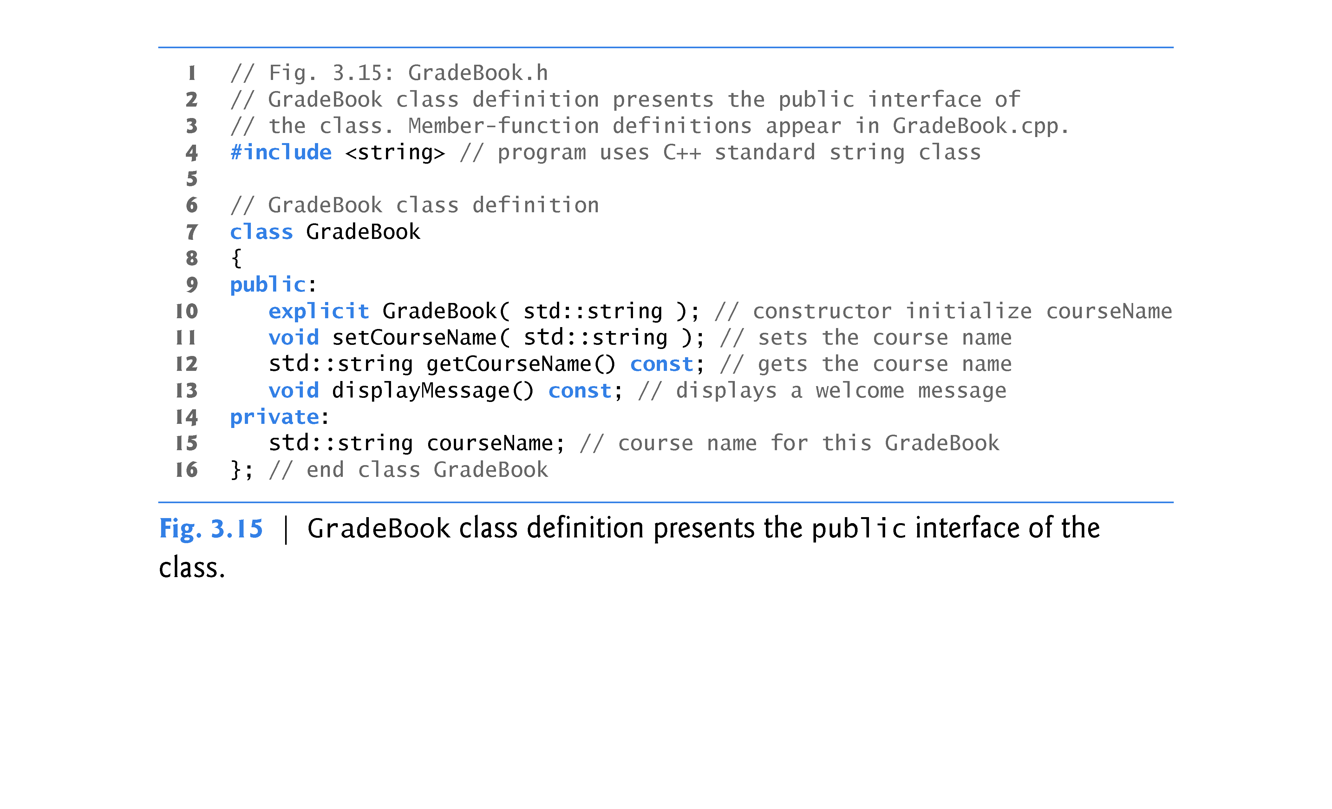

Slide 70
3.8 Validating Data with set Functions (cont.)
The C++ Standard Library’s string class defines a member function length that returns the number of characters in a string object.
A consistent state is a state in which the object’s data member contains a valid value.
Class string provides member function substr (short for “substring”) that returns a new string object created by copying part of an existing string object.
The first argument specifies the starting position in the original string from which characters are copied.
The second argument specifies the number of characters to copy.

Slide 71
3.10 Validating Data with set Functions (cont.)
Figure 3.17 demonstrates the modified version of class GradeBook (Figs. 3.15–3.16) featuring validation.
In previous versions of the class, the benefit of calling setCourseName in the constructor was not evident.
Now, however, the constructor takes advantage of the validation provided by setCourseName.
The constructor simply calls setCourseName, rather than duplicating its validation code.

Slide 72
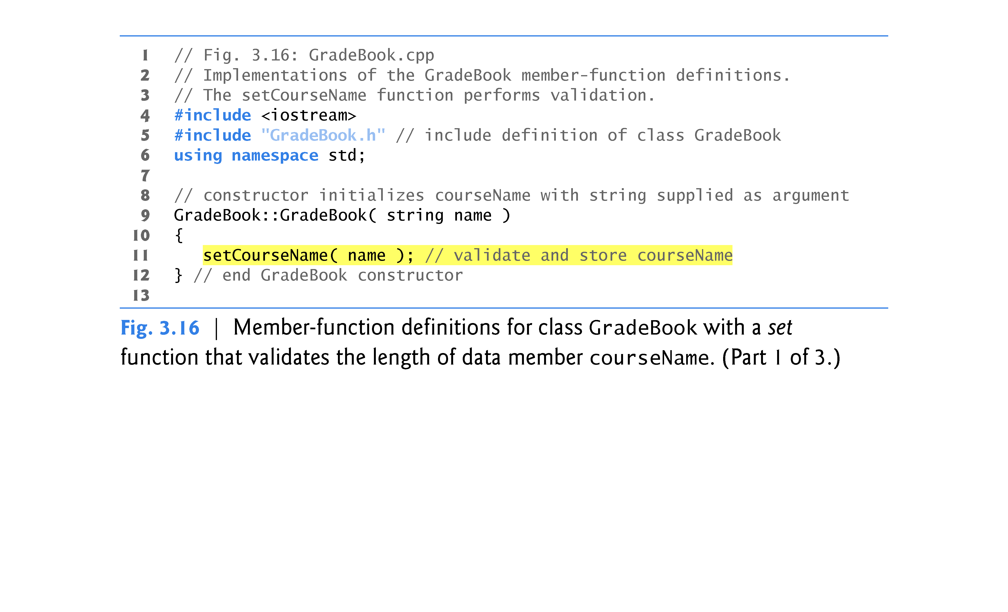

Slide 73
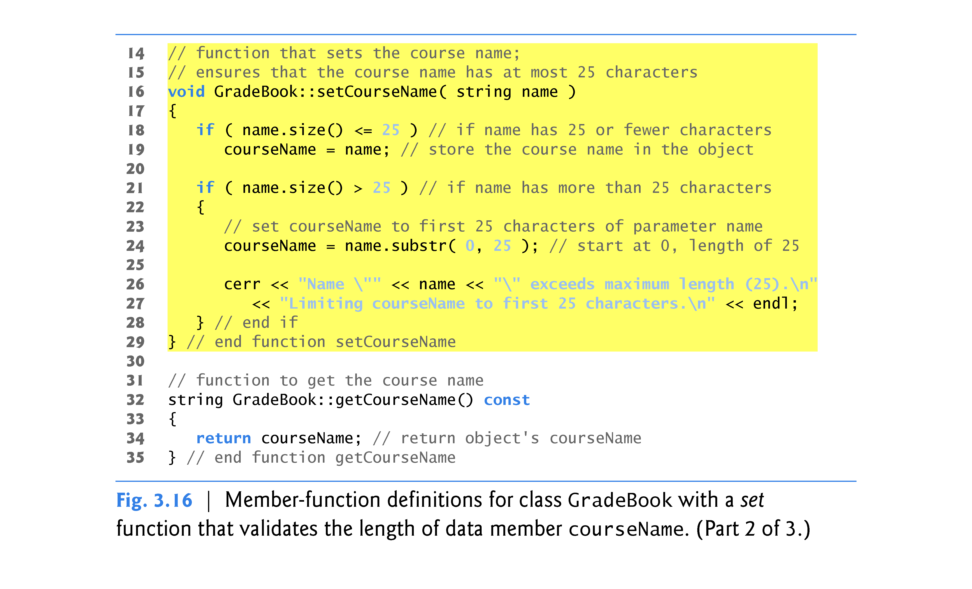

Slide 74
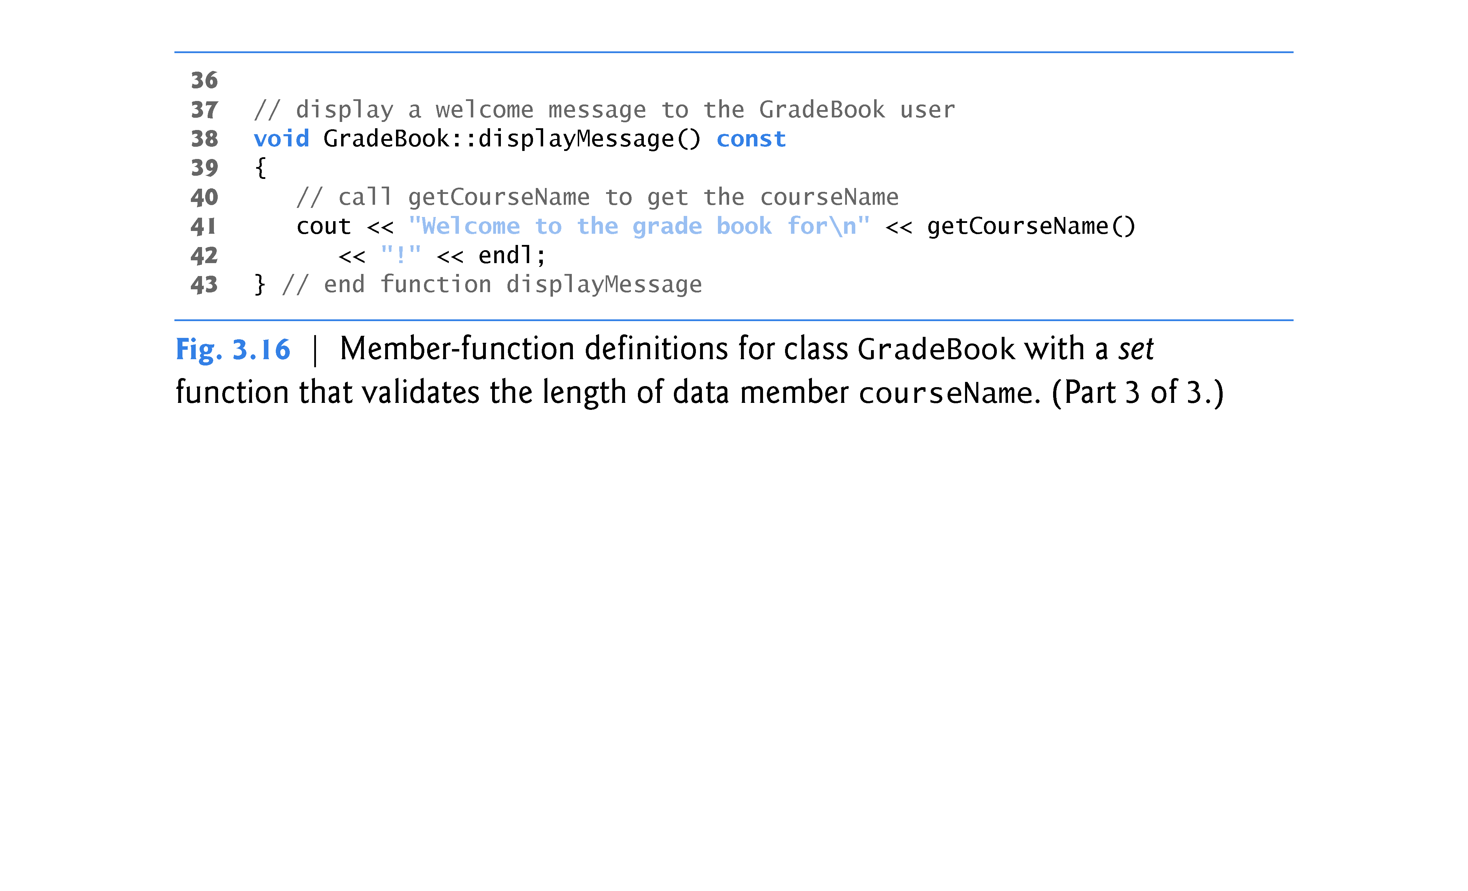

Slide 75
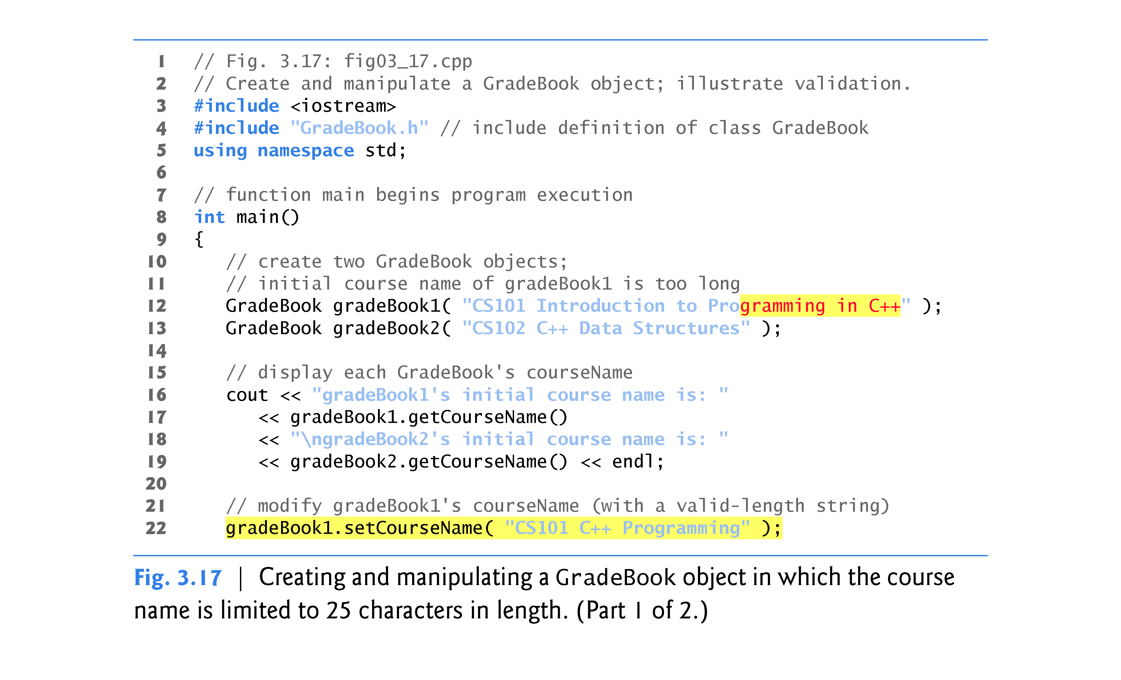

Slide 76
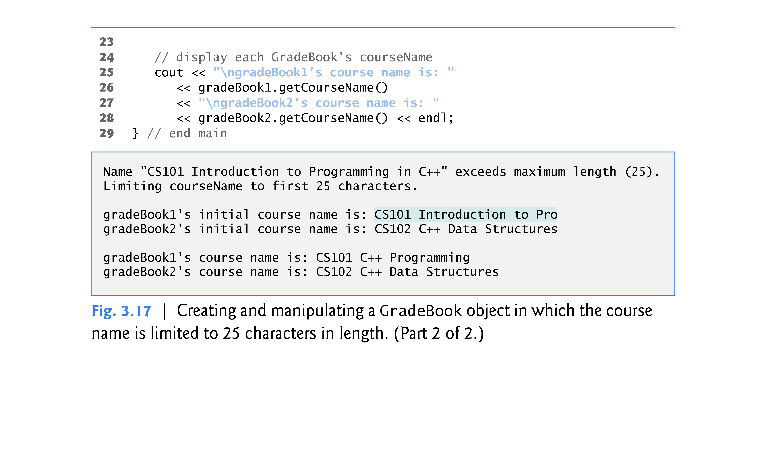

Slide 77
3.8 Validating Data with set Functions (cont.)
A public set function such as setCourseName should carefully scrutinize any attempt to modify the value of a data member (e.g., courseName) to ensure that the new value is appropriate for that data item.
A set function could return a value indicating that an attempt was made to assign invalid data to an object of the class.
A client could then test the return value of the set function to determine whether the attempt to modify the object was successful and to take appropriate action if not.

